Slide 1
DEPARTMENT OF PHYSICS
SRM INSTITUTE OF SCIENCE AND TECHNOLOGY
18PYB103J –Semiconductor Physics
LECTURE 2
DENSITY OF STATES ENERGY BANDS IN SOLIDS
18PYB103J Module-I Lecture-2

Slide 2
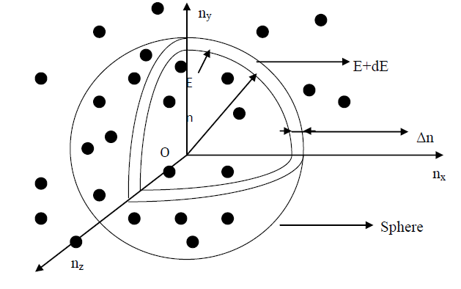
DENSITY OF STATES
Definition: Density of States Z (E) dE is defined as the number of available electron states per unit volume in an energy interval (dE).
To find the number of energy levels in a cubical metal piece and to find number of electrons that can be filled in a given energy level, let us construct a sphere of radius ‘n’ in the space.
18PYB103J Module-I Lecture-2

Slide 3
The sphere is further divided in to many shells and each of this shell represents a particular combination of quantum numbers (nx, ny, and nz) and therefore represents a particular energy value.
Let us consider two energy values E and E + dE. The number of energy states between E and E + dE can be found by finding the number of energy states between the shells of the radius n and n + Δn, from the origin.
The number of energy states within the sphere of radius n = 4/3 π n³ Since n_{x}, n_{y}, and n_{z} will have only positive values, we have to take only one octant of the sphere (i.e) 1/8 th of the sphere volume.
18PYB103J Module-I Lecture-2

Slide 4
The number of available energy states within the sphere of radius
n = 1/8 [4/3 π n³]
Similarly the number of available energy states within the sphere of radius
n + dn = 1/8 [4/3 π (n+dn)³]
The number of available energy states between the shells of radius n and n + dn (or) between the energy levels
E and E + dE = 1/8 [4/3 π (n+dn)³- 4/3 π n³ ]
The number of available energy states between the energy interval
Z(E)dE = 1/8 X 4/3 π [n³+dn³+3n²dn+3dn²n- n³]
18PYB103J Module-I Lecture-2

Slide 5
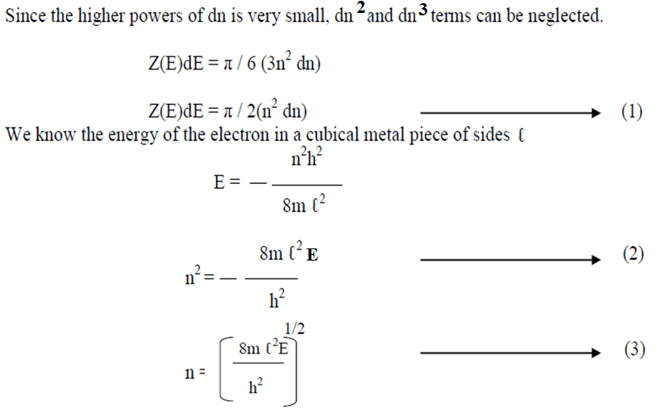
18PYB103J Module-I Lecture-2

Slide 6
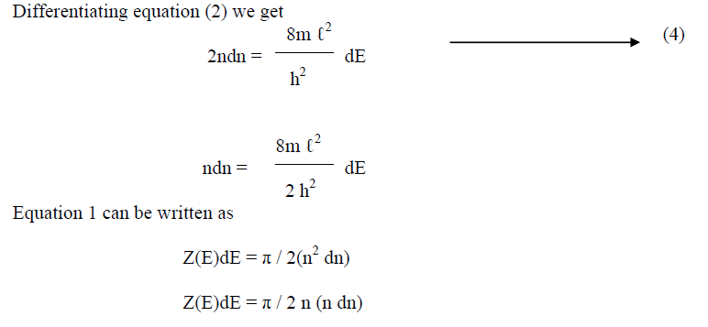
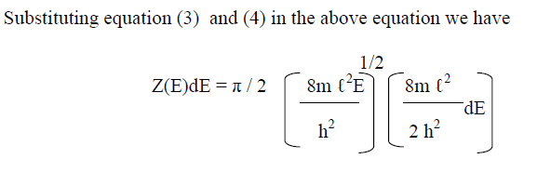
18PYB103J Module-I Lecture-2

Slide 7
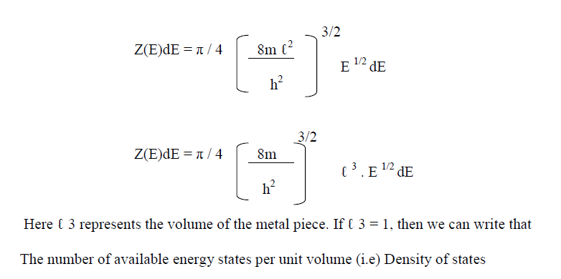
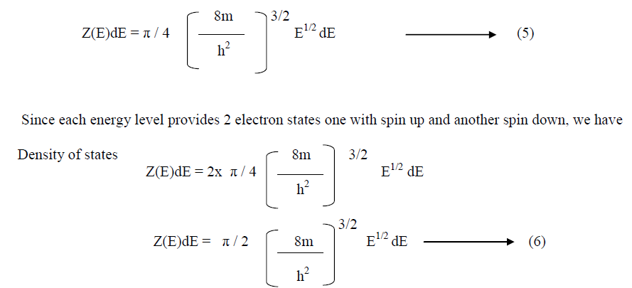
18PYB103J Module-I Lecture-2

Slide 8
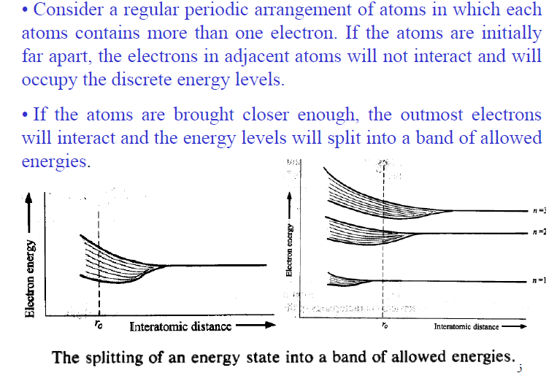
Energy bands in solids
18PYB103J Module-I Lecture-2

Slide 9
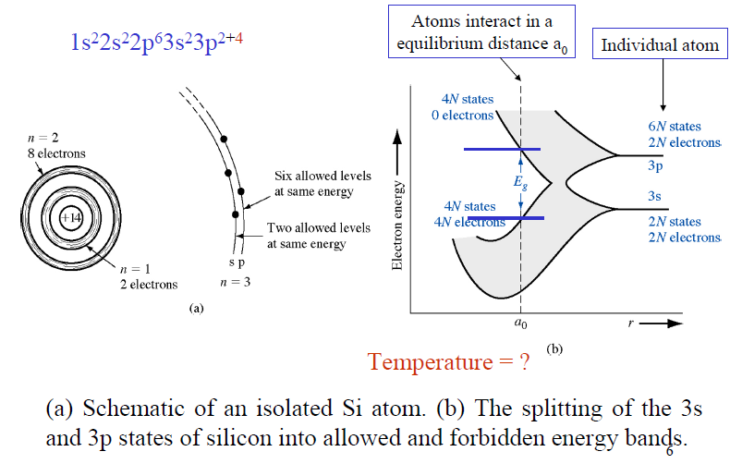
18PYB103J Module-I Lecture-2

